Slide 1

Stats 101 Session 1
IDC All Star Cohort 10
Date: 20 March 2023

Slide 2
Agenda
Day 1
Descriptive statistics
Visualizations – Descriptive statistics
Outliers handling
Missing values imputation
Scaling and normalization
Transformations
Day 2
Distributions
Power Analysis
Overview of Tests & models
Univariate vs Bivariate analysis

Slide 3
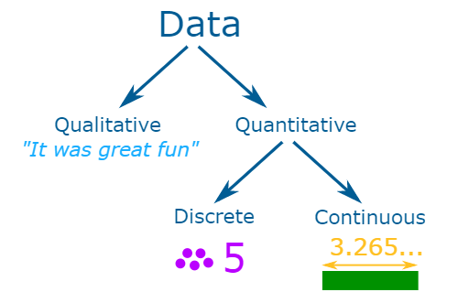
What is Data
Data is a collection of facts, such as numbers, words, measurements, observations or just descriptions of things.
Data can be qualitative or quantitative.
Qualitative data is descriptive information (it describes something)
Quantitative data is numerical information (numbers)
Quantitative data can be Discrete or Continuous:
Discrete data can only take certain values (like whole numbers)
Continuous data can take any value (within a range)
Population VS Sample
A Population/Census is when we collect data for every member of the group.
A Sample is when we collect data just for selected members of the group.

Slide 4
Common Data Types
Machine Learning
Interval
Temperature/Date
Ratio
Market share/crime rate/conversion rate
Ordinal
Income levels: “less than 50K”/“50K-100K”/“over 100K”
Nominal
French,/Mexican,/Japanese or Male/Female
Binary
1/0
Deep Learning
Image
Video
Audio
Text
Statistical Methods
Two main statistical methods are used in data analysis: descriptive statistics, which summarizes data using indexes such as mean and median and another is inferential statistics, which draw conclusions from data using statistical tests such as student's t-test

Slide 5
Descriptive Statistics

Slide 6
Descriptive Statistics
Descriptive statistics involves describing, summarizing and organizing the data so it can be easily understood
Methods of describing the characteristics of a data set.
Useful because they allow you to make sense of the data
Includes calculating things such as the average of the data, its spread and the shape it produces
Measures used to describe a dataset:
Measure of position
Measure of spread
Measure of shape

Slide 7
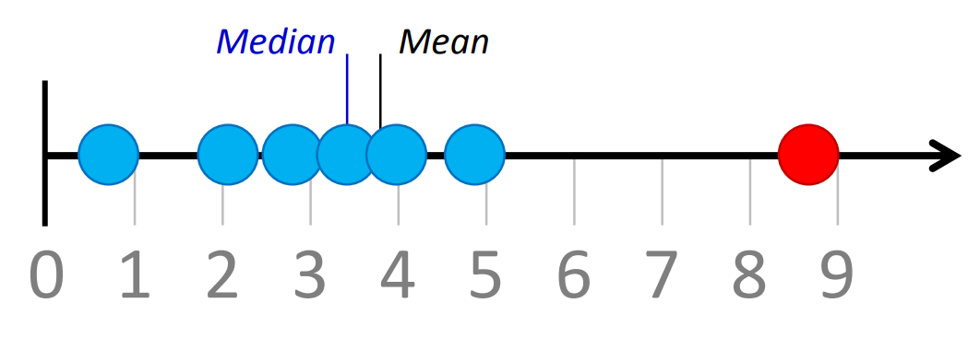
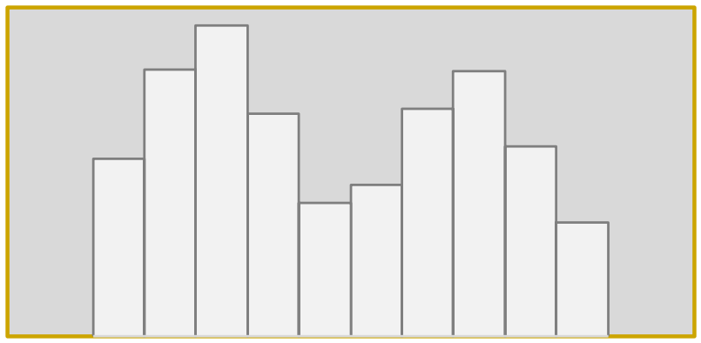
Descriptive Statistics
Measure of position
Position Statistics measure the data central tendency
Central tendency refers to where the data is centered
Three different statistics to describe average of data set:
Mean
Median
Mode
Mean: The total of all the values divided by the size of the data set
works well when the distribution is symmetric and there are no outliers
Median: The middle value where exactly half of the data values are above it and half are below it
can reduce the effect of outliers and used when the data is nonsymmetrical
Mode: The value that occurs the most often in a data set
It is more useful to distinguish between unimodal and multimodal distributions

Slide 8
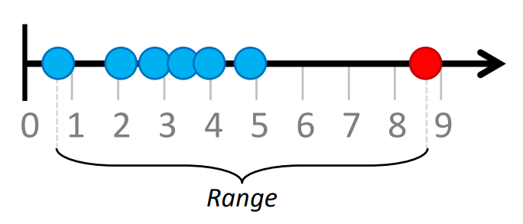
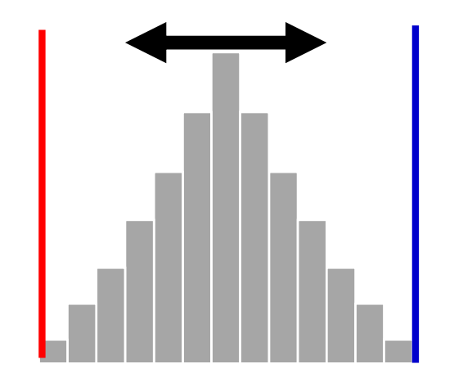
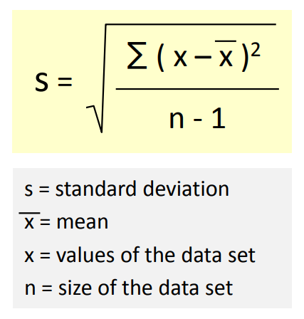
Descriptive Statistics
Measure of spread
The Spread refers to how the data deviates from the position measure
Used to control process variability and improve quality
Different statistics used to describe the spread of a data set:
Range
Standard Deviation
Variance
Range: The difference between the highest and the lowest values
It can be misleading when the data is skewed or in the presence of outliers
Standard Deviation: The average distance of the data points from their own mean
A low standard deviation indicates that the data points are clustered around the mean and vice versa
Standard deviation is computed as follows:

Slide 9
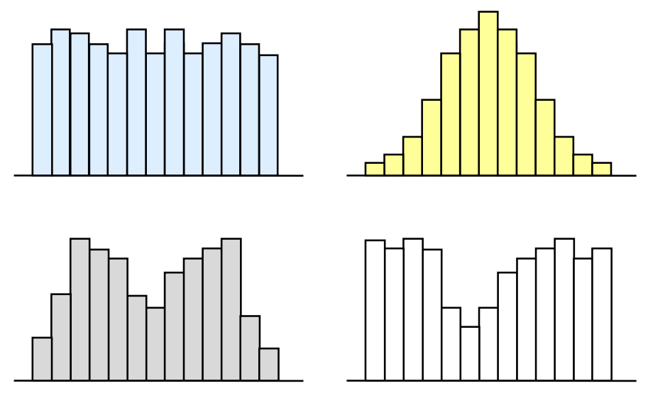
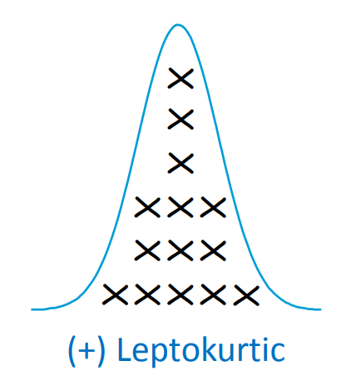
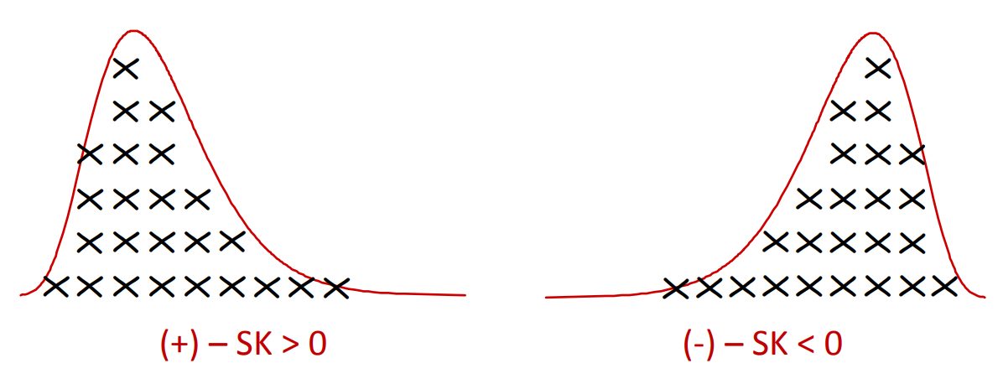
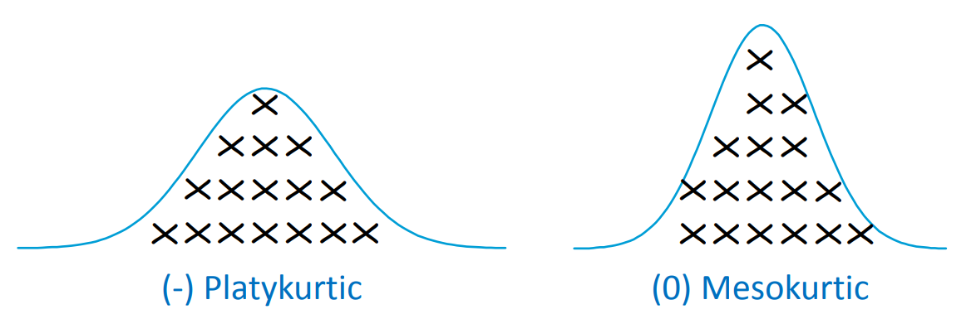
Descriptive Statistics
Measure of shape
The understanding of shape of the data: symmetrical or nonsymmetrical
Symmetrical distribution has two sides of the distribution as mirror image of each other
Examples of symmetrical distributions include Uniform, Normal, Camel-back and Bow-tie shaped
Two common statistics that measure the shape of the data:
Skewness
Kurtosis
Skewness: Describes whether the data is distributed symmetrically around the mean
Skewness value = 0 implies perfect symmetry, negative value implied left-skewed & positive value implies right-skewed
Kurtosis: Measures the degree of flatness (or peakness) of the shape
If data values are clustered around the middle, the distribution is more peaked (greater kurtosis values) and vice versa

Slide 10
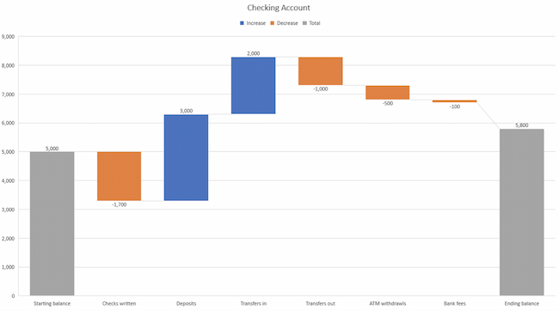
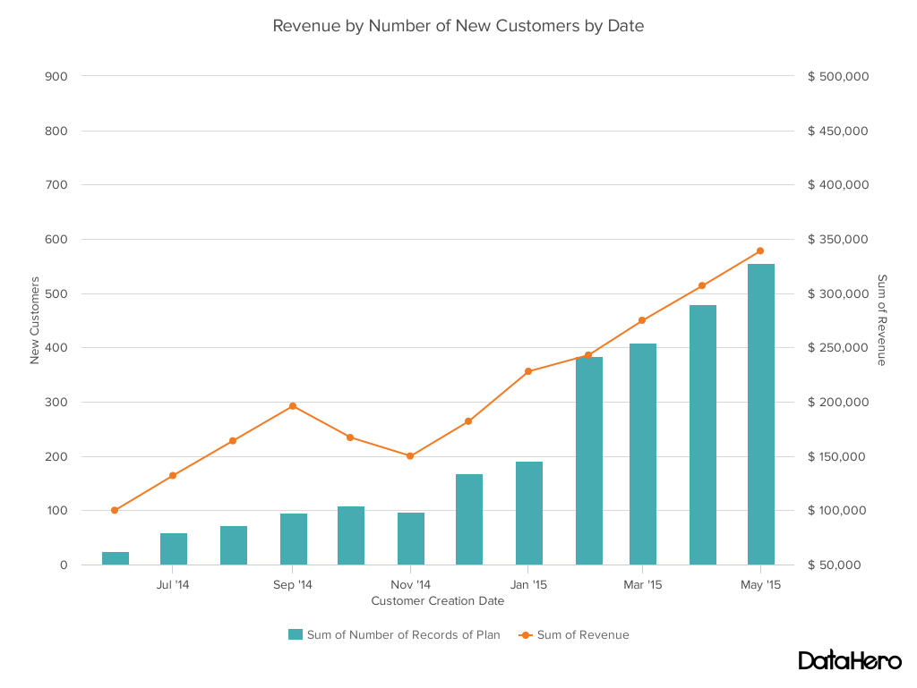
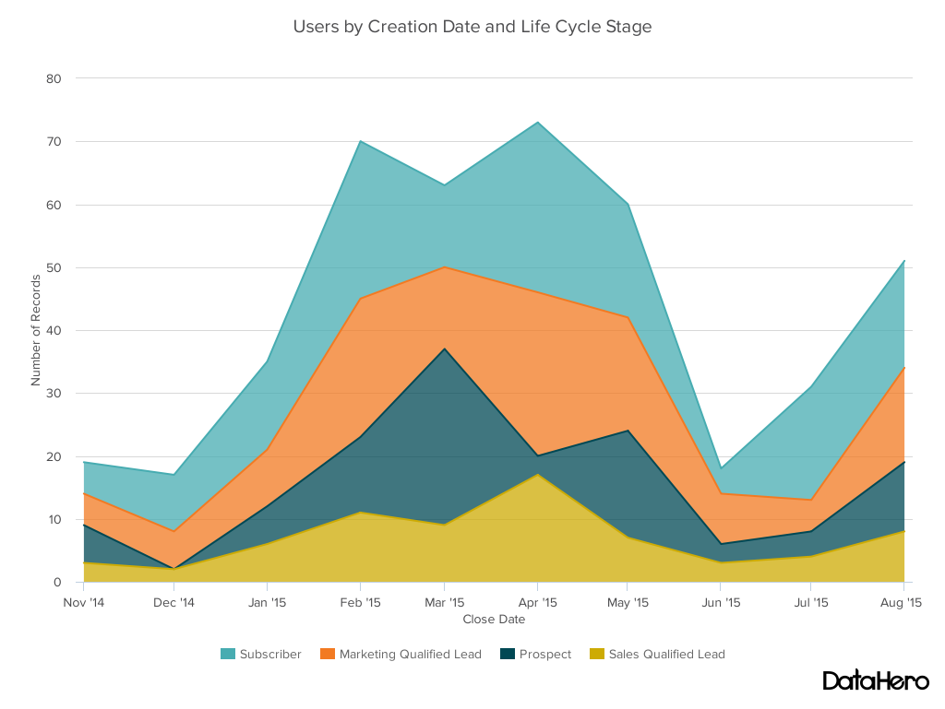
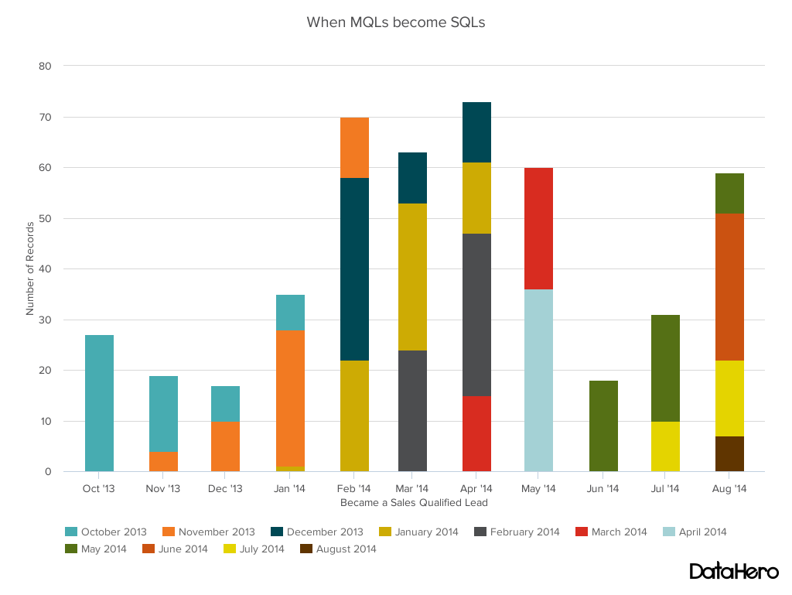
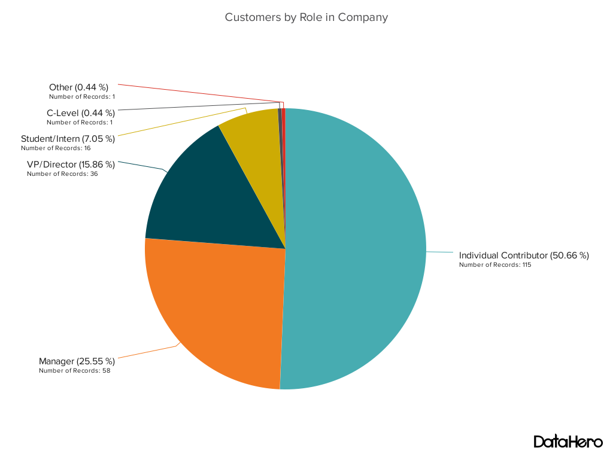
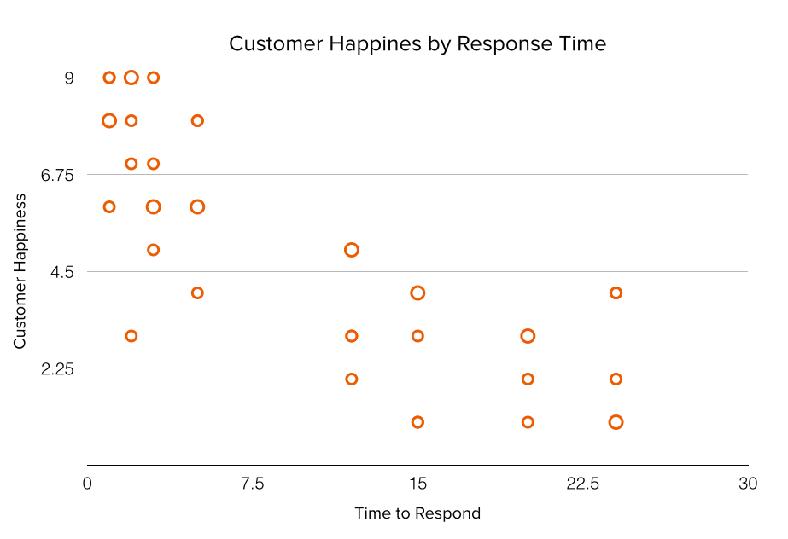
Descriptive Statistics - Visualization

Slide 11
Descriptive Statistics - Visualization
Visualizing continuous variable
Visualizing One Categorical data
Visualizing Two Categorical data
Visualizing Two numeric variables
Visualizing Two numeric and one categorical
Visualizing Two categorical and one numeric

Slide 12
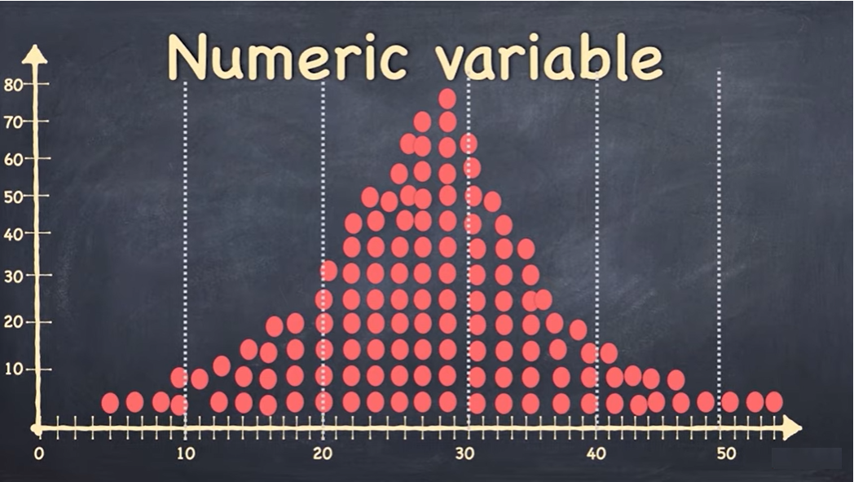
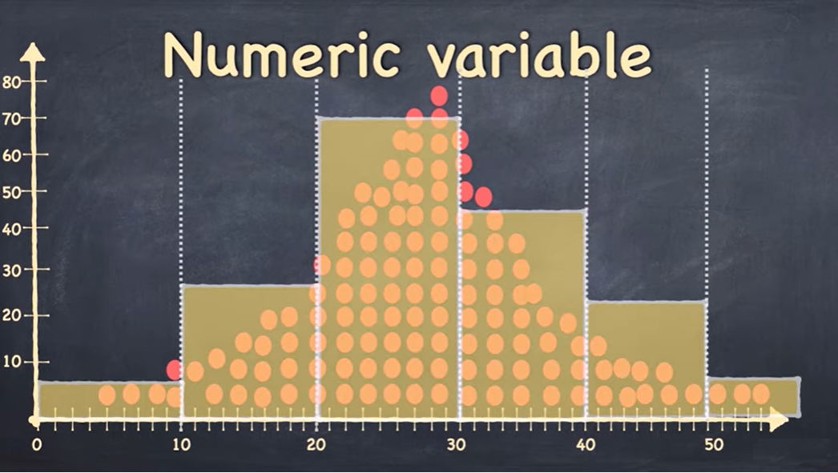
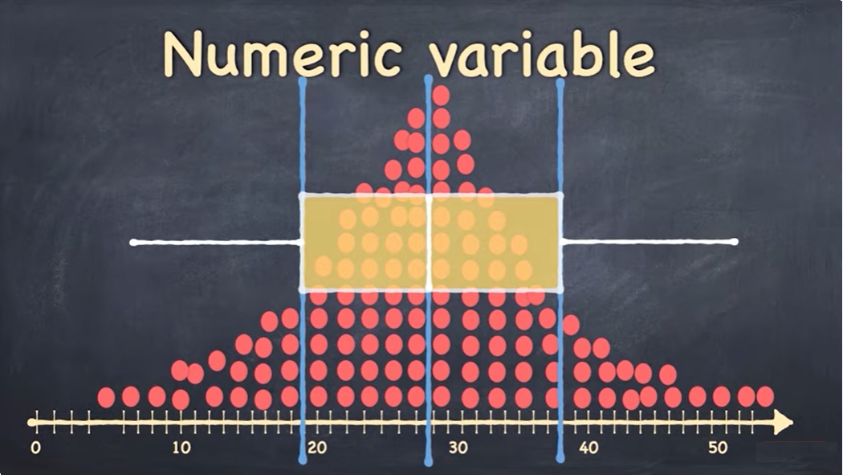
Visualizing continuous variable
Histogram
Box Plot

Slide 13
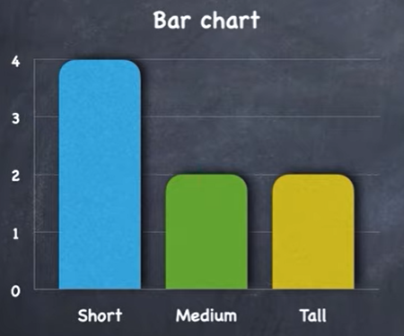
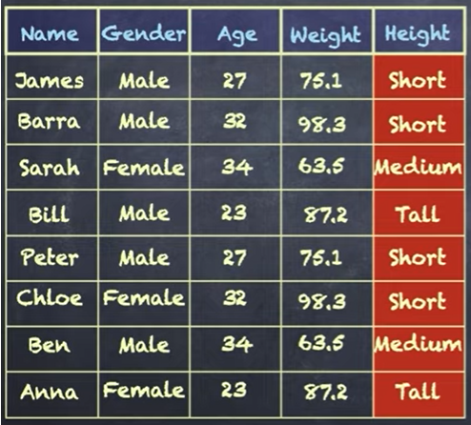
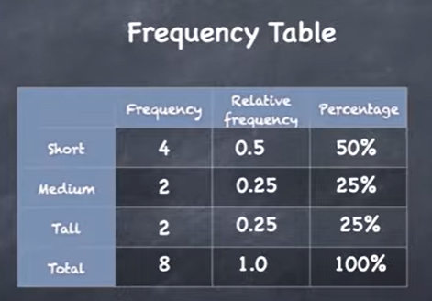
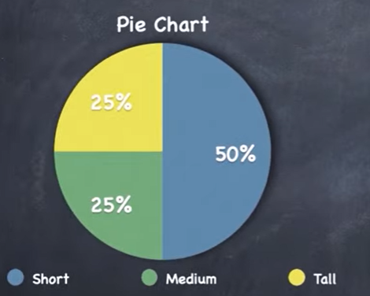
Visualizing One Categorical data
Frequency, Relative Frequency, Percentage
Using Bar Chart, Pie Chart

Slide 14
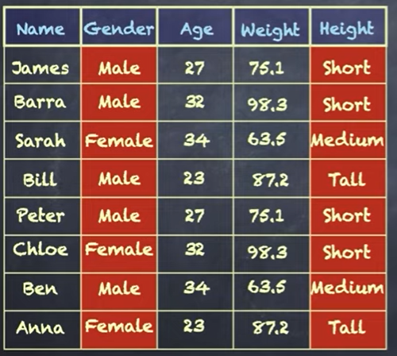
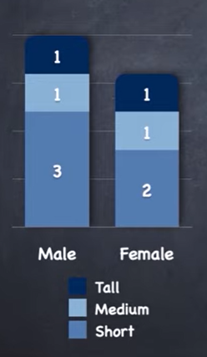
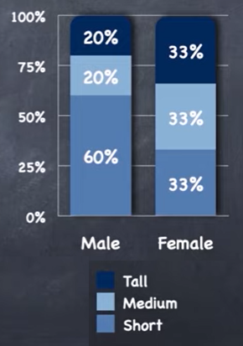
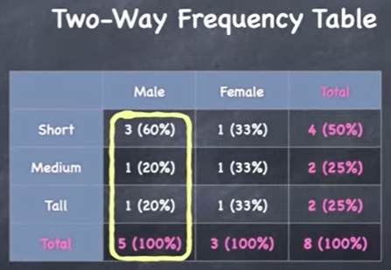
Visualizing Two Categorical data
Two way Frequency Table
Using Stacked Bar chart with numbers or proportions

Slide 15
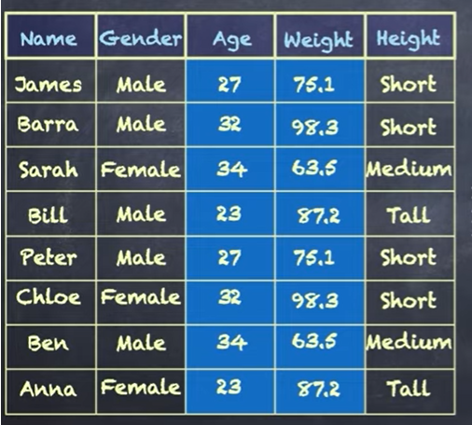
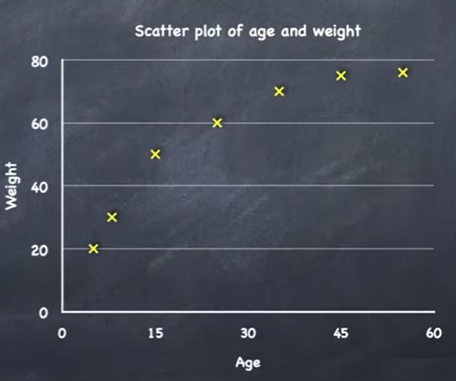
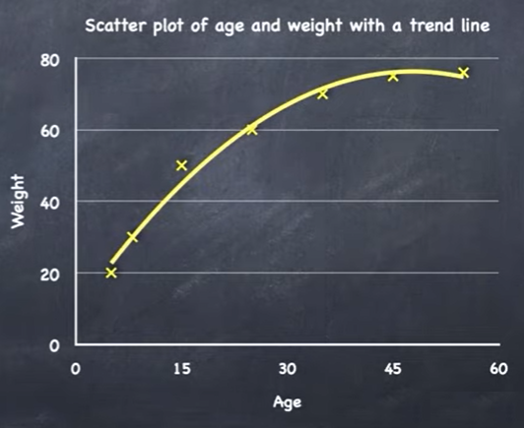
Visualizing Two numeric variables
Scatter Plot
By convention we put independent variable on the x-axis and dependent variable on the y-axis (here weight)

Slide 16
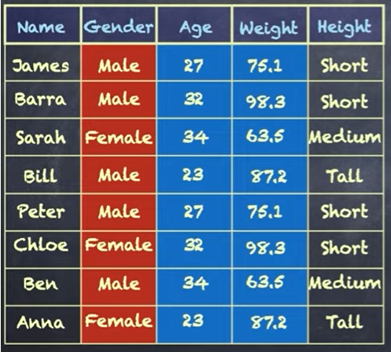
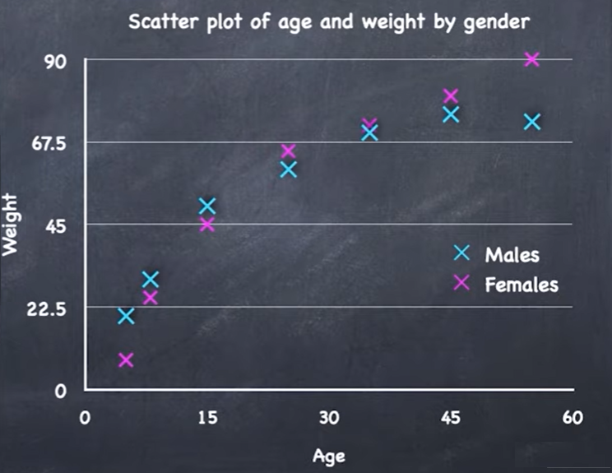
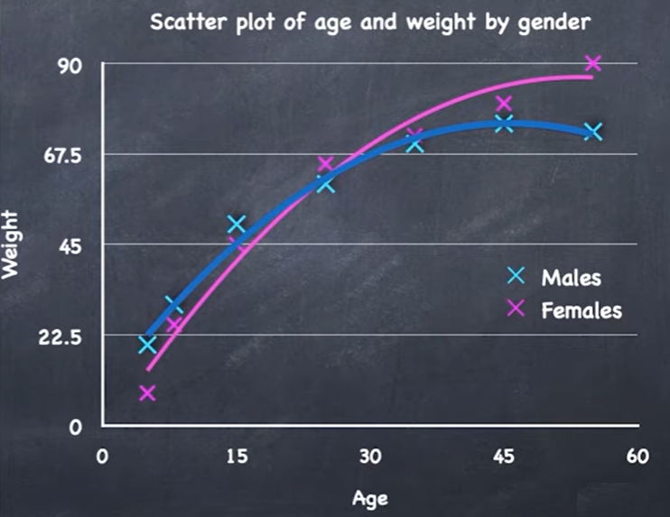
Visualizing Two numeric and one categorical
Scatter Plot with categories in different colors

Slide 17
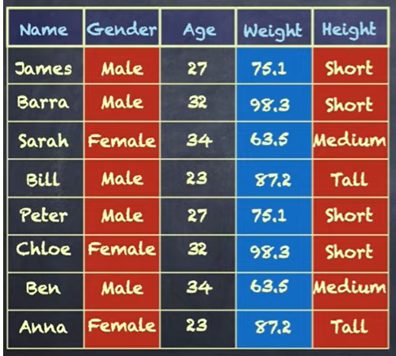
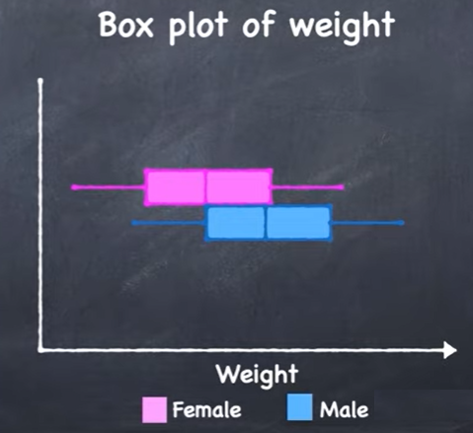
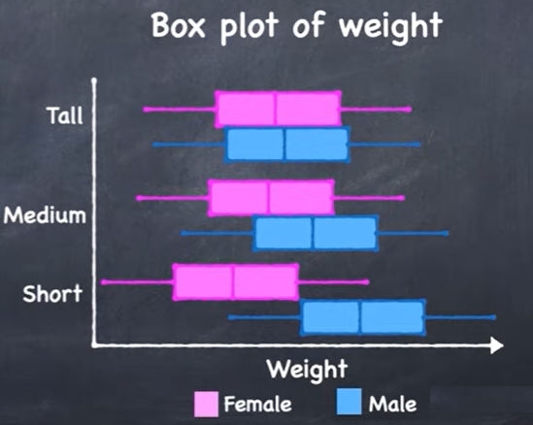
Visualizing Two categorical and one numerical
Box Plot with categories in different colors and disaggregate by other category

Slide 18
Data Processing

Slide 19
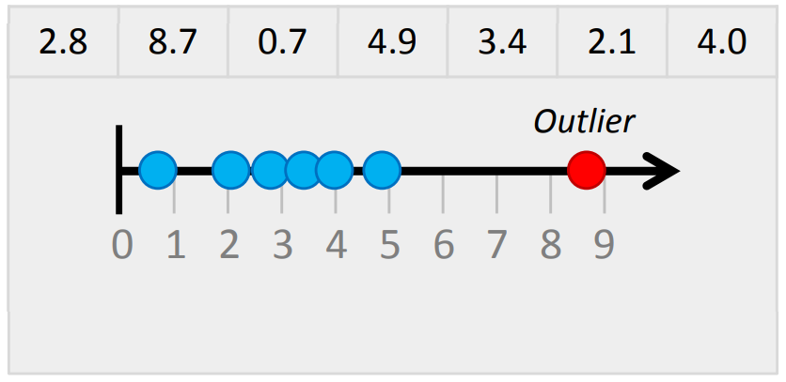
Data Processing
Outliers
A data point that is significantly greater or smaller than other data points in a data set
Ways to detect outliers:
Histograms.
Boxplots.
Normal probability plots
Z-stat value
Outlier treatment:
Decide whether to exclude them before carrying out your analysis
Use methods such as interpolation, replace with 0 or capping at upper and lower thresholds
Time taken to process a sample of applications:

Slide 20
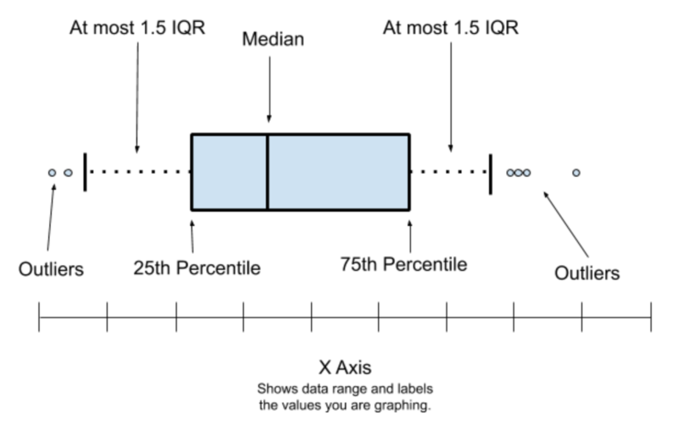
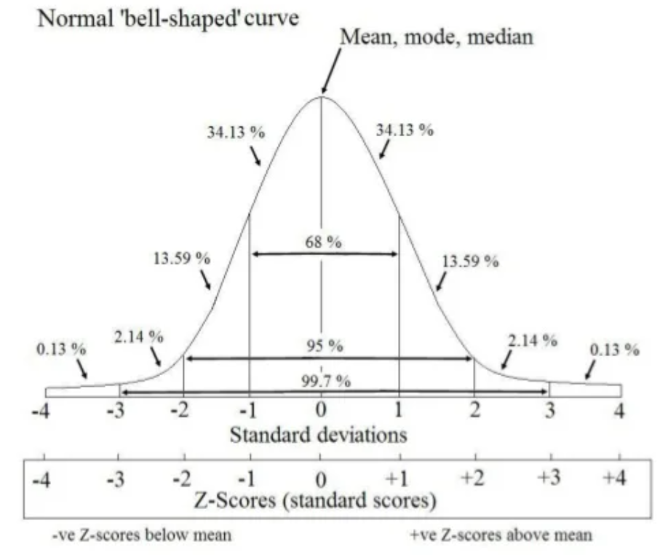
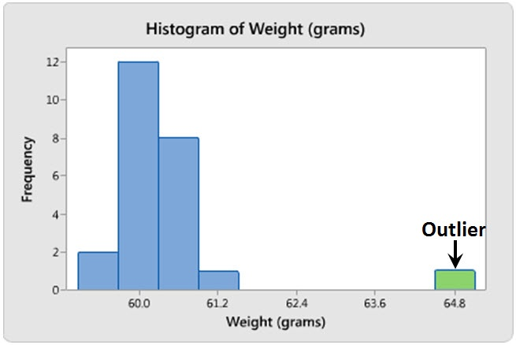
Data Processing
Outliers Examples using plots
Histograms.
Boxplots.
Normal probability plots
Z-stat value
Normal and non distribution approach (IQR & 0.05%)

Slide 21
Missing values imputation

Slide 22
Missing Value Treatment
Deleting Data points with missing values
Impute missing values for continuous variable
Impute missing values for categorical variable
Other Imputation Methods
Prediction of missing values
Imputation using Deep Learning Library

Slide 23
Missing Value Treatment – Deleting data points with missing values
Missing values can be handled by deleting the rows or columns having null values when you have sufficient data
Columns have more than certain % of missing rows can be dropped
Rows having more than certain % of missing columns can be dropped
Decision to be made based on Data availability
Pros:
Model trained with the removal of all missing values creates a robust model
Cons:
Loss of a lot of information.
Works poorly if the percentage of missing values is excessive in comparison to the complete dataset

Slide 24
Impute missing values for continuous variable
Numeric continuous values can be replaced with the mean, median, or mode of remaining values in the column
Numeric values to be converted to bins & index method can be used to impute missing values
Pros:
Prevent data loss which results in deletion of rows or columns
Works well with a small dataset and is easy to implement
Cons:
Works only with numerical continuous variables.
Can cause data leakage
Do not factor the covariance between features

Slide 25
Impute missing values for categorical variable
Missing values can be replaced with the most frequent category
If the number of missing values is very large, then it can be replaced with a new category
Missing values can also be replaced based on index method
Pros:
Prevent data loss which results in deletion of rows or columns
Works well with a small dataset and is easy to implement.
Negates the loss of data by adding a unique category
Cons:
Works only with categorical variables.
Addition of new features to the model while encoding, which may result in poor performance

Slide 26
Other Imputation Methods
Depending on the nature of the data or data type, some other imputation methods may be more appropriate to impute missing values
Last valid observation can be used to fill missing data if data variable has longitudinal behavior
Interpolation using n before and after variables can be used if the data is time series
Back fill can be done in case of initial missing data in time series

Slide 27
Prediction of missing values
Other features which don’t have nulls can be used to predict missing values
The regression or classification model can be used for the prediction of missing values depending on the nature (categorical or continuous) of the feature having missing value
Pros:
Gives a better result than earlier methods
Takes into account the covariance between the missing value column and other columns.
Cons:
Considered only as a proxy for the true values
Adds another model to the pipeline

Slide 28
Imputation using Deep Learning Library - Datawig
Works very well with categorical, continuous, and non-numerical features
Datawig can take a data frame and fit an imputation model for each column with missing values, with all other columns as inputs
DataWig learns Machine Learning models to impute missing values in tables
Pros:
Quite accurate compared to other methods.
It supports CPUs and GPUs.
Cons:
Can be quite slow with large datasets
Adds another model to the pipeline

Slide 29
Scaling & Normalization

Slide 30
Feature Scaling
Why Feature Scaling?
Helps normalize data within a range
Helps speeding up the calculations in algorithm
When Feature Scaling?
Gradient Descent Based Algorithms - Yes
Distance Based Algorithms - Yes
Tree Based Algorithms – No
Feature Scaling Techniques
Min-Max Normalization
Standardization
Max Abs Scaling
Robust Scaling etc.,
Person | Age | Height | Weight
1 | 27 | 180 | 89
2 | 54 | 140 | 75
3 | 32 | 165 | 90
4 | 48 | 150 | 72
5 | 19 | 172 | 75
Magnitude
Units

Slide 31
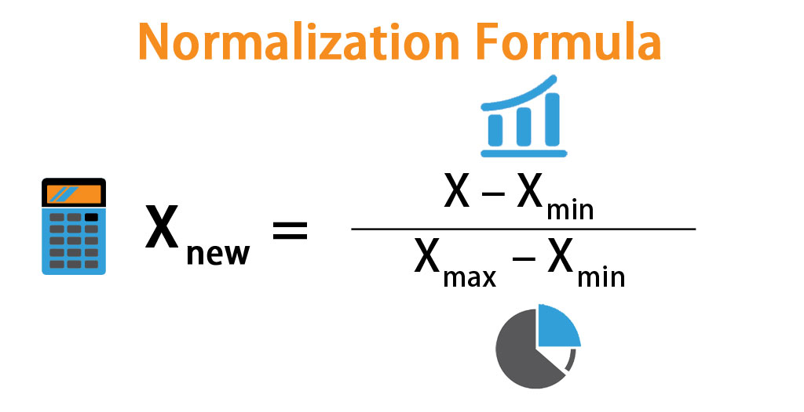
Normalization
Normalization is a scaling technique in which values are shifted and rescaled so that they end up ranging between 0 and 1([-1,-1] when negative)
Also known as Min-Max Scaling
Here, Xmax and Xmin are the maximum and the minimum values of the feature respectively.
When the value of X is the minimum value in the column, the numerator will be 0, and hence X’ is 0
On the other hand, when the value of X is the maximum value in the column, the numerator is equal to the denominator and thus the value of X’ is 1
If the value of X is between the minimum and the maximum value, then the value of X’ is between 0 and 1

Slide 32
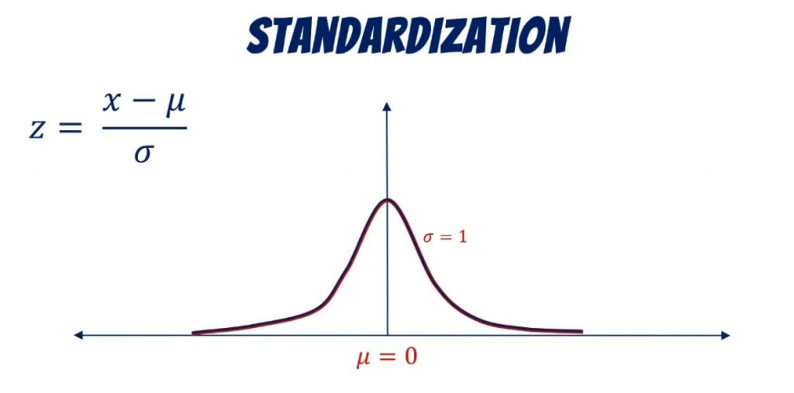
Standardization
Standardization is a scaling technique where values are centred around the mean with a unit standard deviation.
Values are restricted to a particular range
Normalization vs Standardization?

Slide 33
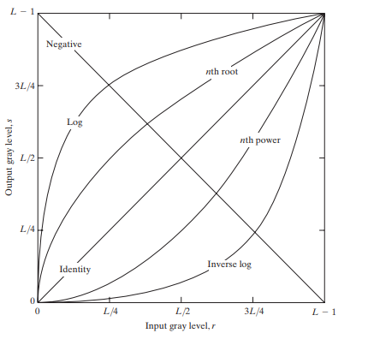
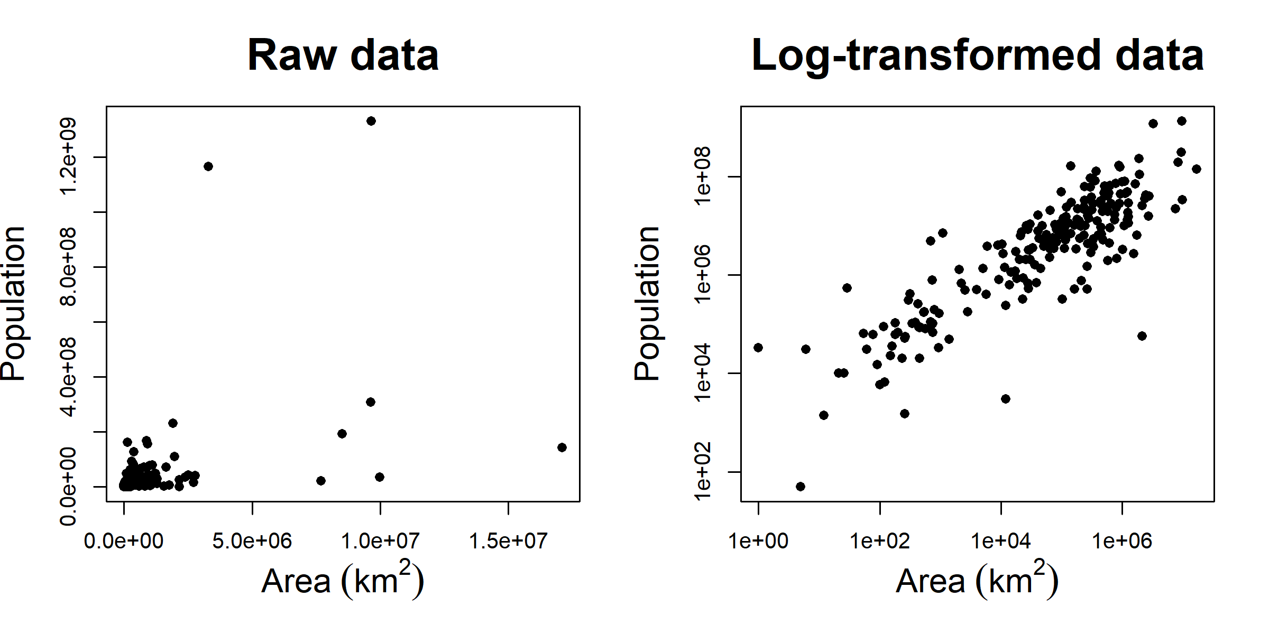
Transformations
Why Transformations?
Reduce skewness in the data
Makes the data more interpretable
Helps to meet the assumptions of some algorithms
Types of Transformations:
Log
Cube
Cube root
Square
Square root
Polynomial
Inverse
Inverse Log
Exponential
Natural Log

Slide 34
Mini Assignment – Day1
Two years of Top 200 Trending videos are provided (a different country data is provided for each AS)
Each AS is required to
Provide your approach towards analyzing the data
Share analysis of the data shared
Some analysis is expected on the lines of
How long does it take for the video to get trending
How is this duration changes across the two years
Channels having multiple trending videos and how many times
Analysis around likes, views, comments, etc.

Slide 35
Thank you
Questions?

